Slide 1
数据中心网络
Datacenter Network and Related Research Topics
Lesson 06
Notes:
用chatgpt现场编程？

Slide 2
How to read a paper
How to find a paper？DBLP and CCF rank.
How to read a paper? Three stage approach
Read quickly in brief
Read with greater care; ignore proofs
Deconstruct paper; question all assumptions
How to reproduce a paper? Using experiment tools and contact authors.

Slide 3
About this course
Questions to answer while preparing your presentation:
What is the background of this paper?
What problem are the authors solving? Why it is important?
What is the main idea and what do you think of it?
What was the status quo ante before this paper, and what is this paper’s contribution?
What is the experiment setting of this paper, and what is the main results?
Can you reproduce the paper? If not, what is the difficulties?
Notes:
除了互联网之外
数据中心网络
CDN
社会网络
无线传感网
这些都是基于网络概念的延申，是最近十年来网络研究的结果

Slide 4
Topic 2: Network programming
Notes:
除了互联网之外
数据中心网络
CDN
社会网络
无线传感网
这些都是基于网络概念的延申，是最近十年来网络研究的结果

Slide 5




Network programming
App develop
Cloud computing
Online game server
In the Internet time, every program interacts with network and needs network programming.

Slide 6
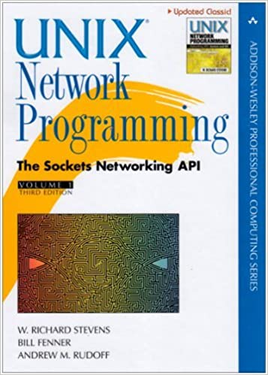
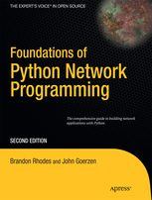
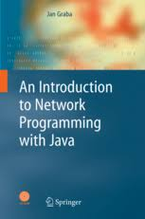
Network programming
A basic skill every networking people should have.
Network programming=Knowledgeable in networking + Skillful in programming
Notes:
成为一个高级的程序员

Slide 7
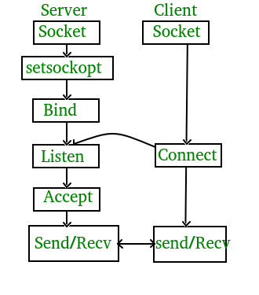
Network programming
Basis of this basic skill --- socket.
What is socket programming?
Socket is a way of connecting two nodes on a network to communicate with each other.

Slide 8
Network programming
Basis of this basic skill --- socket.
int sockfd = socket(domain, type, protocol)
domain: integer, communication domain e.g., AF_INET (IPv4 protocol) , AF_INET6 (IPv6 protocol) type: communication type SOCK_STREAM: TCP(reliable, connection oriented) SOCK_DGRAM: UDP(unreliable, connectionless) protocol: Protocol value for Internet Protocol(IP), which is 0. This is the same number which appears on protocol field in the IP header of a packet.(man protocols for more details)
Notes:
socket提供了流（stream）和数据报（datagram）两种通信机制，即流socket和数据报socket。
流socket基于TCP协议，是一个有序、可靠、双向字节流的通道，传输数据不会丢失、不会重复、顺序也不会错乱。就像两个人在打电话，接通后就在线了，您一句我一句的聊天。
数据报socket基于UDP协议，不需要建立和维持连接，可能会丢失或错乱。UDP不是一个可靠的协议，对数据的长度有限制，但是它的速度比较高。就像短信功能，一个人向另一个人发短信，对方不一定能收到。
在实际开发中，数据报socket的应用场景极少，本教程只介绍流socket。

Slide 9
Network programming
Basis of this basic skill --- socket.
int bind(int sockfd, const struct sockaddr *addr, socklen_t addrlen);
After creation of the socket, bind function binds the socket to the address and port number specified in addr(custom data structure).
int listen(int sockfd, int backlog);
It puts the server socket in a passive mode, where it waits for the client to approach the server to make a connection.
The backlog, defines the maximum length to which the queue of pending connections for sockfd may grow.

Slide 10
Network programming
Basis of this basic skill --- socket.
int new_socket= accept(int sockfd, struct sockaddr *addr, socklen_t *addrlen);
It extracts the first connection request on the queue of pending connections for the listening socket, sockfd, creates a new connected socket, and returns a new file descriptor referring to that socket.
At this point, connection is established between client and server, and they are ready to transfer data.
send(new_socket , hello , strlen(hello) , 0 );

Slide 11
Network programming
Basis of this basic skill --- socket.
At the client side
Socket establishment: Exactly same as that of server’s socket creation
Socket connection:
int connect(int sockfd, const struct sockaddr *addr, socklen_t addrlen);
valread = read( sock , buffer, 1024);

Slide 12
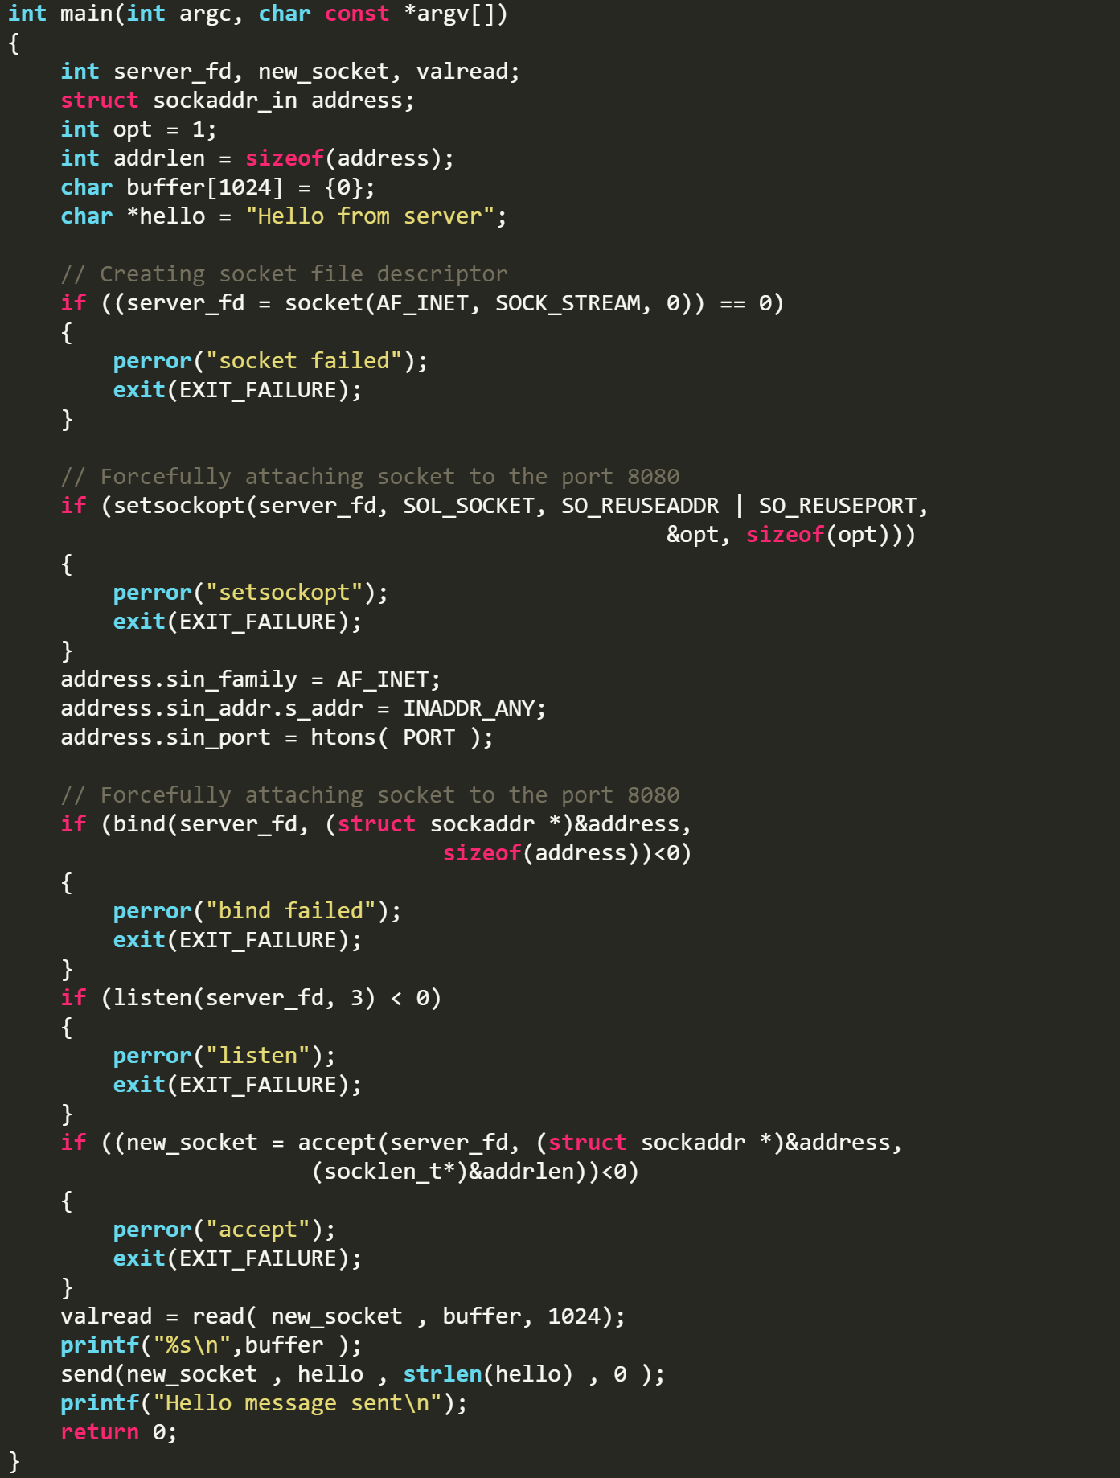
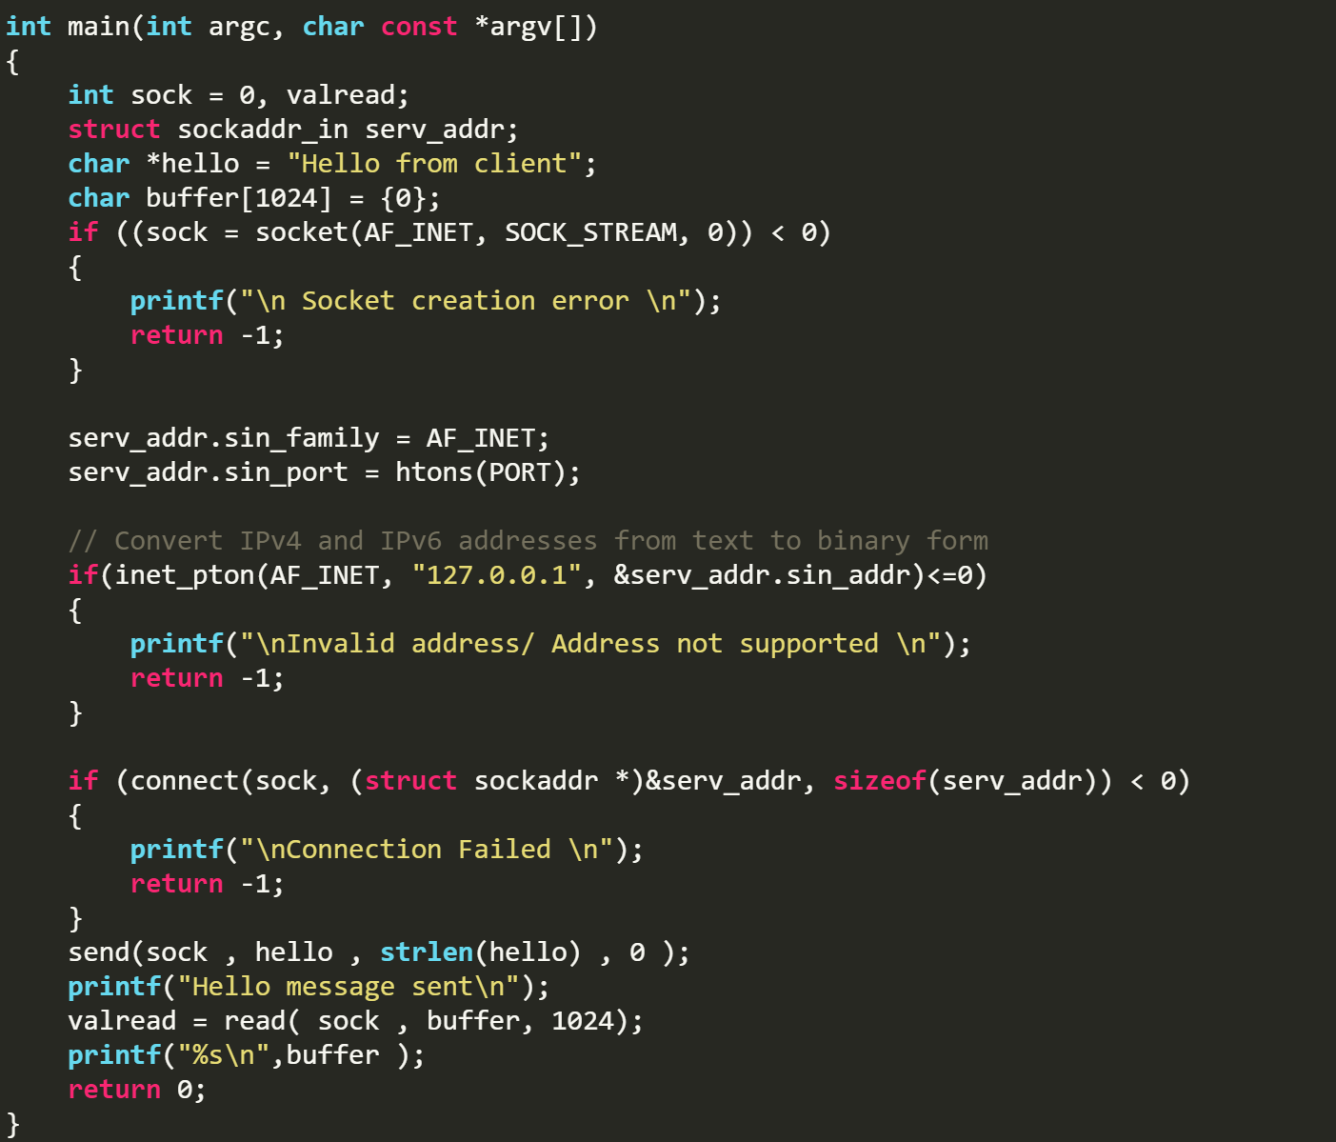
Server side
Client side
An example that two people can talk with each other using sockets.
Notes:
Each time accept returns a new connected socket, the server calls serve_connection; note that this is a blocking call - until serve_connection returns, accept is not called again; the server blocks until one client is done before accepting a new client. In other words, clients are serviced sequentially.
大尾端 big-endian：高位在低地址。小尾端 little-endian：低位在低地址
网络是大尾： ，x 86架构是小尾：
报文地址 1 2 3 4
0x 00 00 00 01
内存地址 1 2 3 4
0x 01 00 00 00

Slide 13



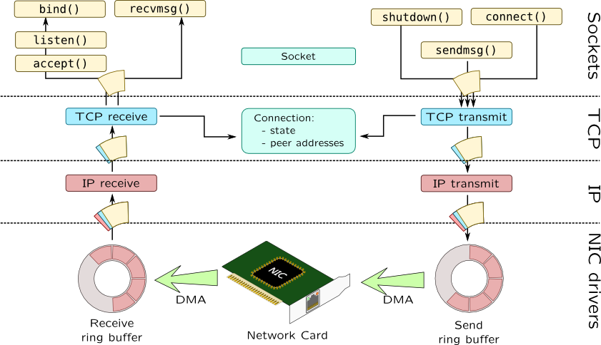
Network programming
What beyond the basic socket.
File transfer
Chat
Video steaming
User space
Kernel space
Hardware driver

Slide 14
Network programming
From the application level:
Some tips about the stream transferring:
How to transfer a large file?
How to transfer a complex object?
How to serve a lot of clients?

Slide 15
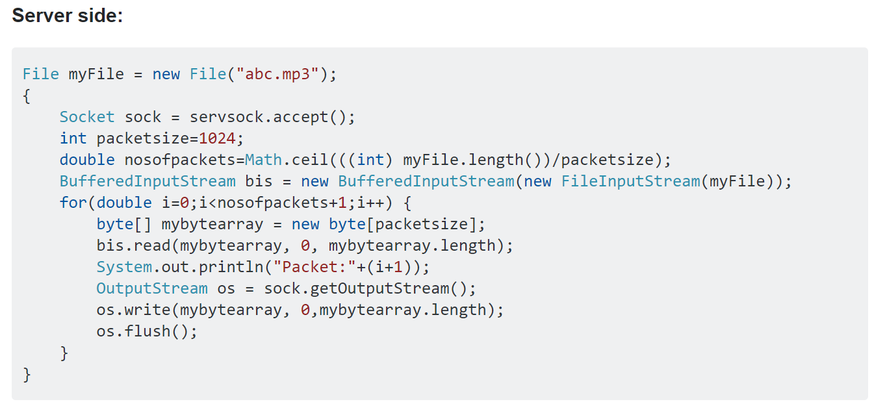
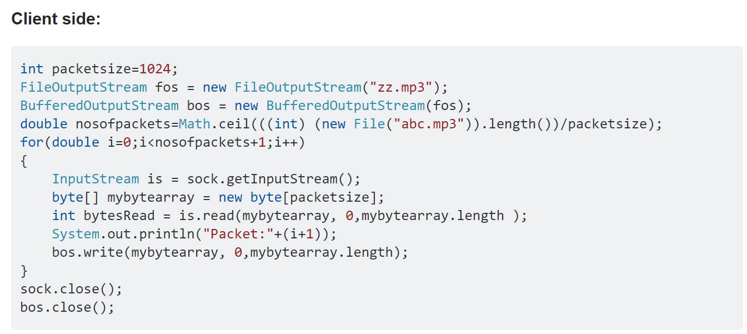
Network programming
How to transfer a large file?
The client sends the file size to the server side.
The client counts the number of packets sent.
c. The sever reserve the space of the file size.
d. The server counts the number of packets sent.
Notes:
Can know how many bytes have been sent
Resent when the connection crashes.

Slide 16
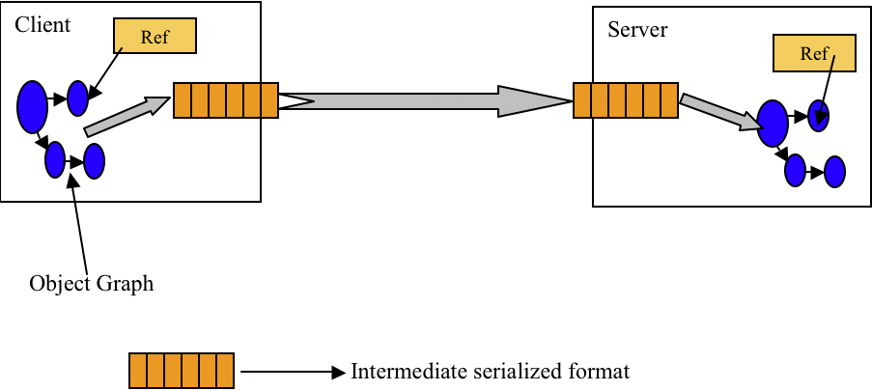
Network programming
Some tips about the stream transferring:
2. How to transfer a complex object?
Serialization: process of translating data structures or object state into a format that can be transmitted.
Deserialization: the opposite operation
Notes:
我们单方面的只把对象转成字节数组还不行，因为没有规则的字节数组我们是没办法把对象的本来面目还原回来的，所以我们必须在把对象转成字节数组的时候就制定一种规则（序列化），那么我们从IO流里面读出数据的时候再以这种规则把对象还原回来（反序列化）。
如果我们要把一栋房子从一个地方运输到另一个地方去，序列化就是我把房子拆成一个个的砖块放到车子里，然后留下一张房子原来结构的图纸，反序列化就是我们把房子运输到了目的地以后，根据图纸把一块块砖头还原成房子原来面目的过程

Slide 17

Network programming
2. How to transfer a complex object?
Some common methods:
Using serializable data formats: JSON (a lighter plain-text alternative to XML which is also commonly used for client-server communication, especially web)
Using sterilization functions supported by the languages: e.g.
Some data not serializable: static, transient
Notes:
Implementing the interface marks the class as "okay to serialize", and Java then handles serialization internally.
There are no serialization methods defined on the Serializable interface

Slide 18
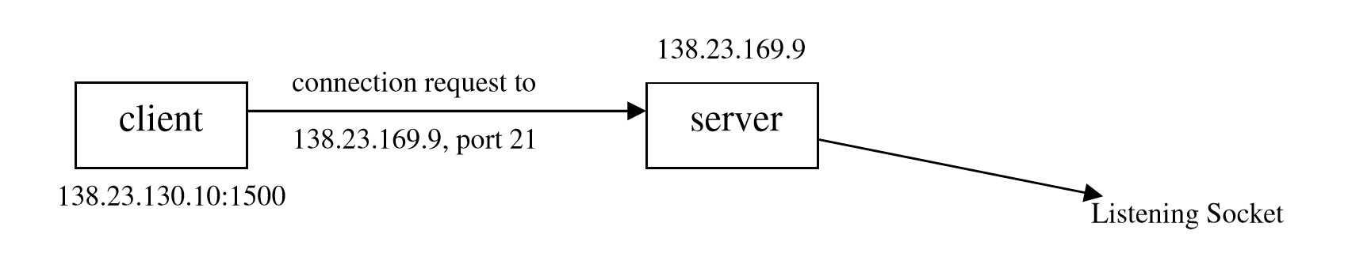
Network programming
3. How to serve a lot of clients?
The basic server is iterative, i.e. it iterates through each client and serves one request at a time.
busy
Client with IP address 138.23.130.10 requests to connect to Server (with IP 138.23.169.9 listening from port 21) from its local port number 1500.

Slide 19
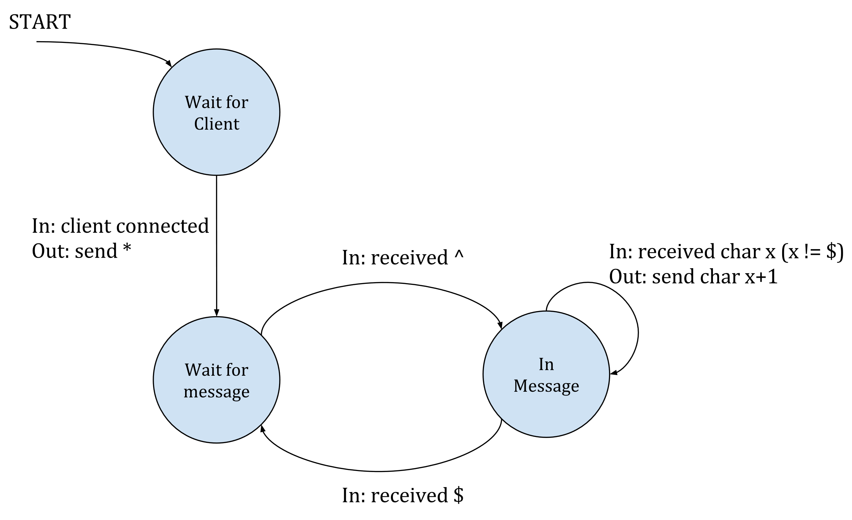
Network programming
3. How to serve a lot of clients?
Stateful TCP server:
Wait for client
Hand shake and wait for messages
Busy processing and ack back
Receiving the FIN signal and back to the initial state
Notes:
make it clear that clients are only handled one at a time. As long as the server is busy dealing with a client in serve_connection, it doesn't accept new client connections. Only when the current client disconnects does serve_connection return and the outer-most loop may accept new client connections.
The protocol used throughout this series is very simple, but should be sufficient to demonstrate many interesting aspects of concurrent server design. Notably, the protocol is stateful - the server changes internal state based on the data clients send, and its behavior depends on that internal state. Not all protocols all stateful - in fact, many protocols over HTTP these days are stateless - but stateful protocols are sufficiently common to warrant a serious discussion.
Here's the protocol, from the server's point of view
In words: the server waits for a new client to connect; when a client connects, the server sends it a * character and enters a "wait for message state". In this state, the server ignores everything the client sends until it sees a ^ character that signals that a new message begins. At this point it moves to the "in message" state, where it echoes back everything the client sends, incrementing each byte [1]. When the client sends a $, the server goes back to waiting for a new message. The ^ and $ characters are only used to delimit messages - they are not echoed back.

Slide 20
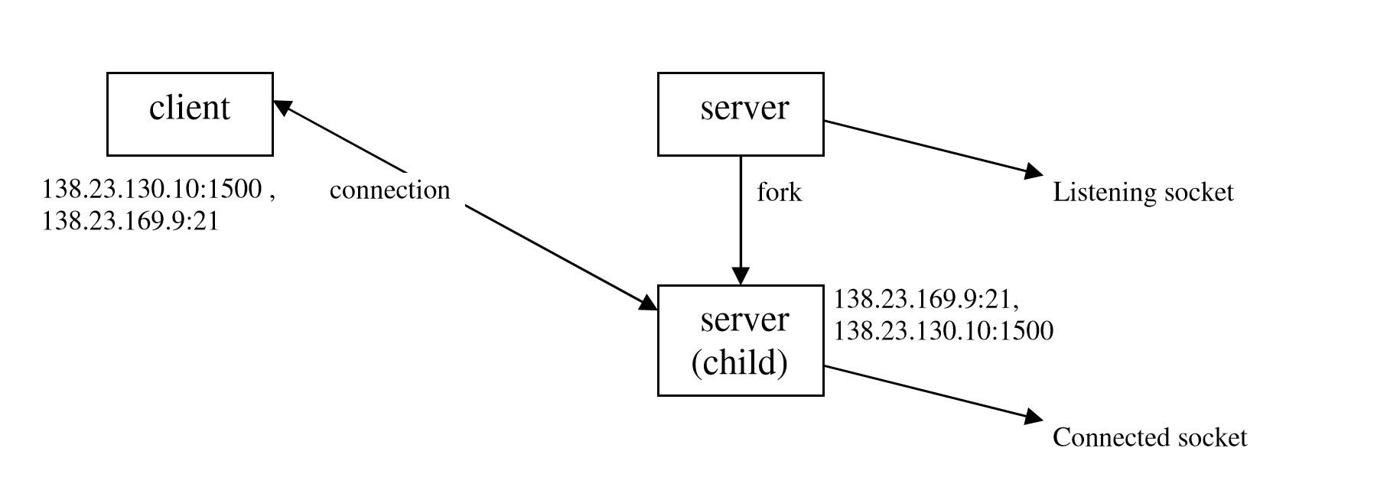
Network programming
Solution: concurrent server.
Server fork()s a copy of itself and lets the child handle this client from port 21, but it concurrently keeps listening (by the parent process) from port 21 as well.
Notes:
The fork command creates a new separate process for each client. The fork() command splits the current process into two processes: a parent and a child. The new process (child process) is an almost exact copy of the process that calls it (the parent process).

Slide 21
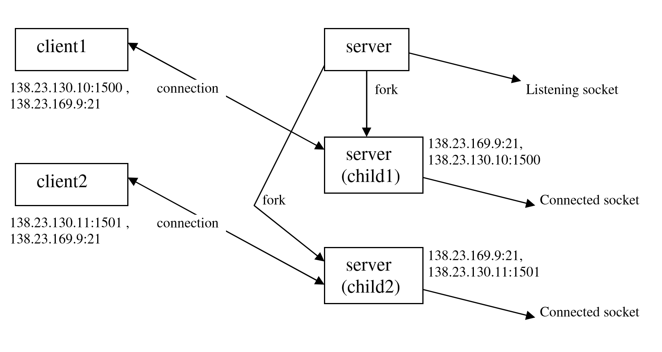
Network programming
Solution: concurrent server.
Another client requests to connect to this server. The server fork()s another copy of itself and lets this second child handle this client, whereas it still concurrently keeps listening from port 21 (by the parent process) and keeps serving client1 from port1 (by the first child process).
Notes:
The listening socket must be distinguished from the connected socket on the server host. Although both sockets use the same local port on the server machine, they are indicated by distinct socket file descriptors, returned server’s call of functions socket() and accept() respectively for listening and connected sockets.
Notice from figure 3 above that TCP must look at all four segments in the socket pair to determine which endpoint receives an arriving segment. In this figure, there are 3 sockets with the same local port 21 on the server. If a segment arrives from 138.23.130.10 port 1500 destined for 138.23.169.9 port 21, it is delivered to the first child. If a segment arrives from 138.23.130.11 port 1501 destined for 138.23.169.9 port 21, it is delivered to the second child. All other TCP segments destined for port 21 are delivered to the original listening socket.

Slide 22
Network programming
Solution: concurrent server.
The problem of fork():
The fork command creates a new separate process for each client. (Environment, Attached shared memory, Process state, Libraries )
The father process take full responsibility of scheduling the child process. (Zoombies problems)
Notes:
When a child exits, it sends a signal to the parent to inform it has finished execution. The Linux operating system will not completely get rid of this process when it exits, but keeps important information as to if the child exited normally, how much cpu time was used, etc. The parent is required to clean up after its children and if it does not, these children hang around, they do nothing because they are finished, and so they are called zombies. Zombies take up space in the kernel and are useless and at some point might be dangerous because we might run out of processes.

Slide 23
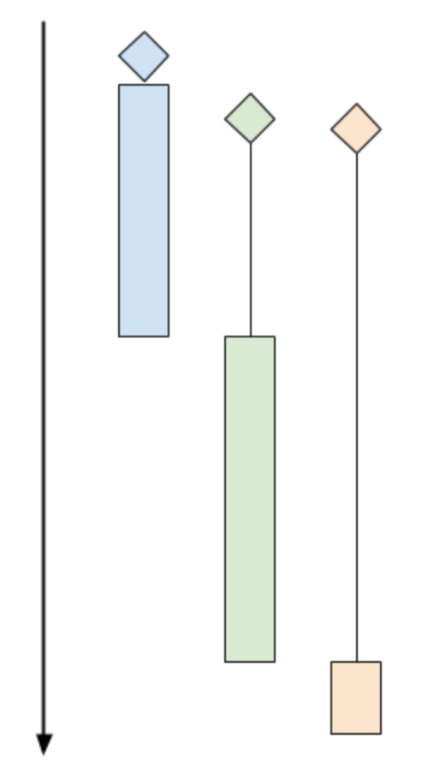
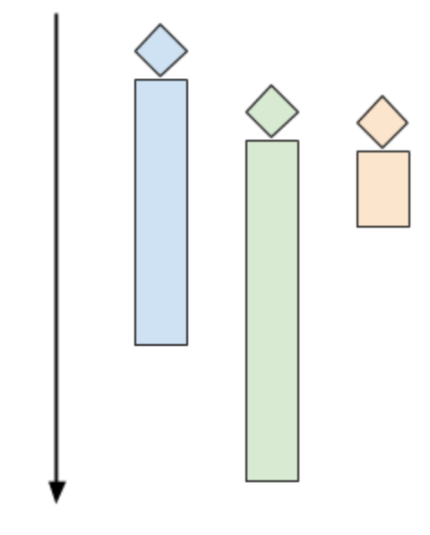
Network programming
Solution: concurrent server by multi-threads (multi-threaded server )
Launch multiple control threads
Let the OS manage concurrency on the CPU
The main thread waits for connections
A thread is created to serve the connected clients
Ideal situation
Notes:
The diagrams shows 3 clients. The diamond shapes denote the client's "arrival time" (the time at which the client attempted to connect to the server). The black lines denote "wait time" (the time clients spent waiting for the server to actually accept their connection), and the colored bars denote actual "processing time" (the time server and client are interacting using the protocol). At the end of the colored bar, the client disconnects.
In the diagram above, even though the green and orange clients arrived shortly after the blue one, they have to wait for a while until the server is done with the blue client. At this point the green client is accepted, while the orange one has to wait even longer.
A multi-threaded server would launch multiple control threads, letting the OS manage concurrency on the CPU (and across multiple CPU cores). When a client connects, a thread is created to serve it, while the server is ready to accept more clients in the main thread. The time chart for this mode looks like the following:

Slide 24
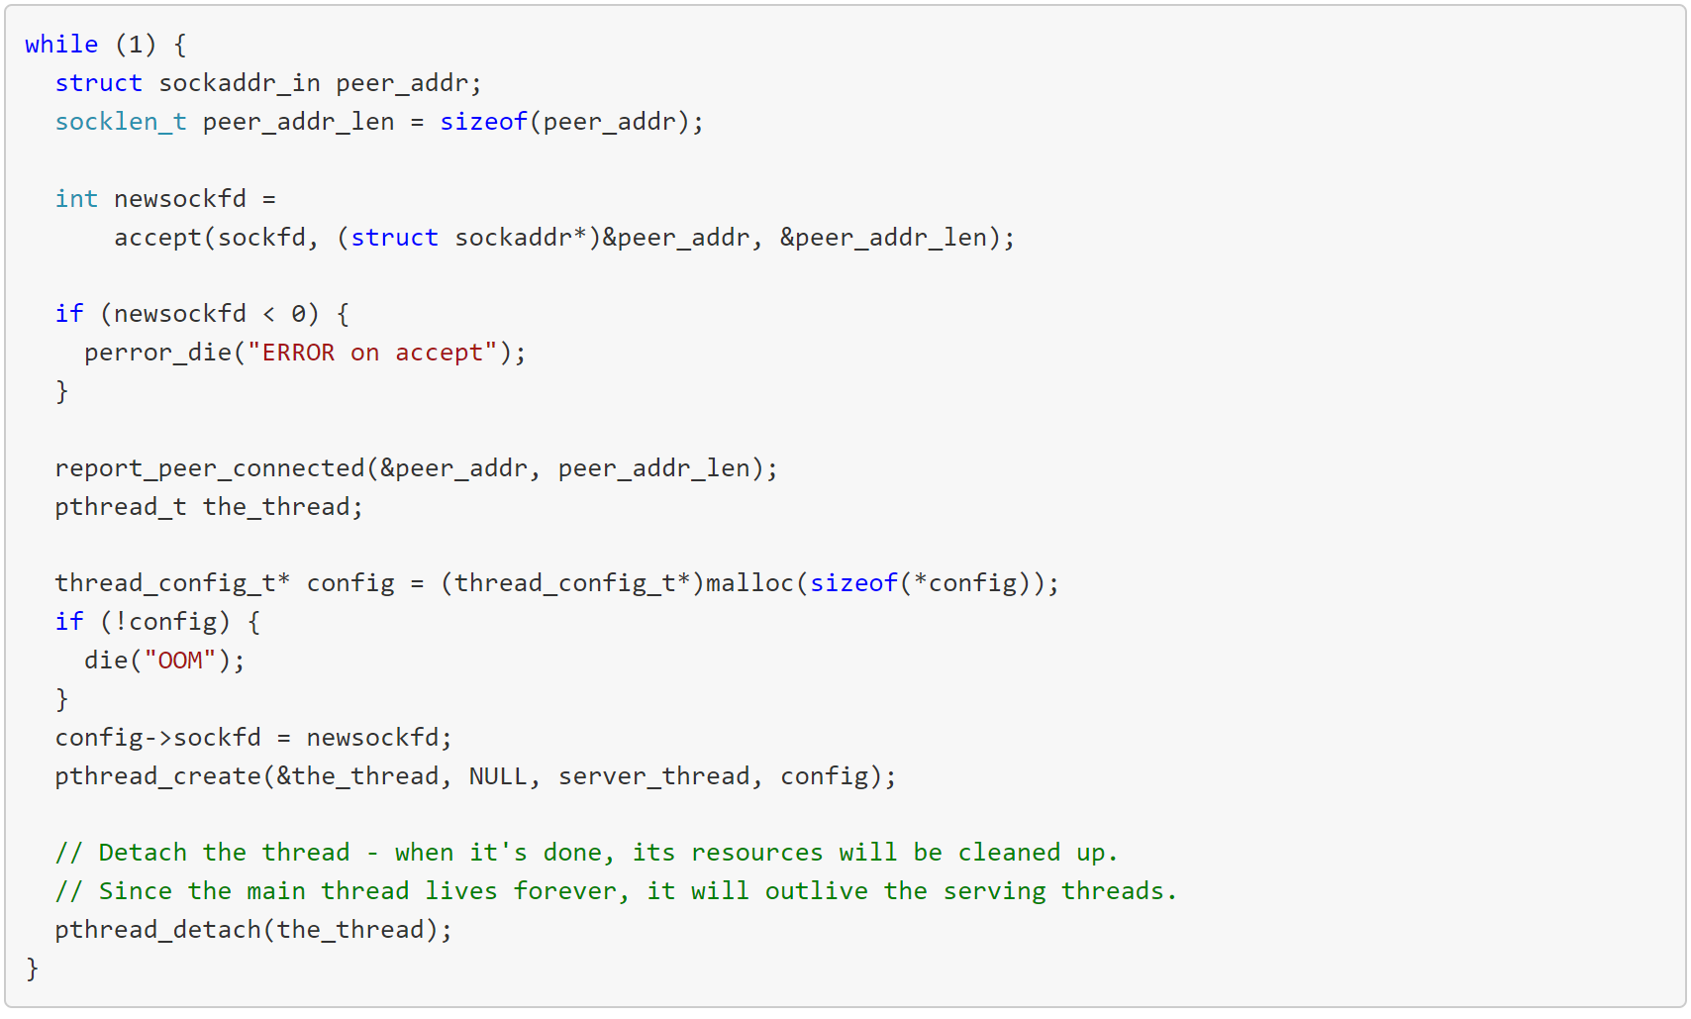
Sample code
Notes:
The pthread_create call in the main loop launches a new thread that runs the server_thread function. This thread terminates when server_thread returns. In turn, server_thread returns when serve_connection returns. serve_connection is exactly the same function from part 1.

Slide 25
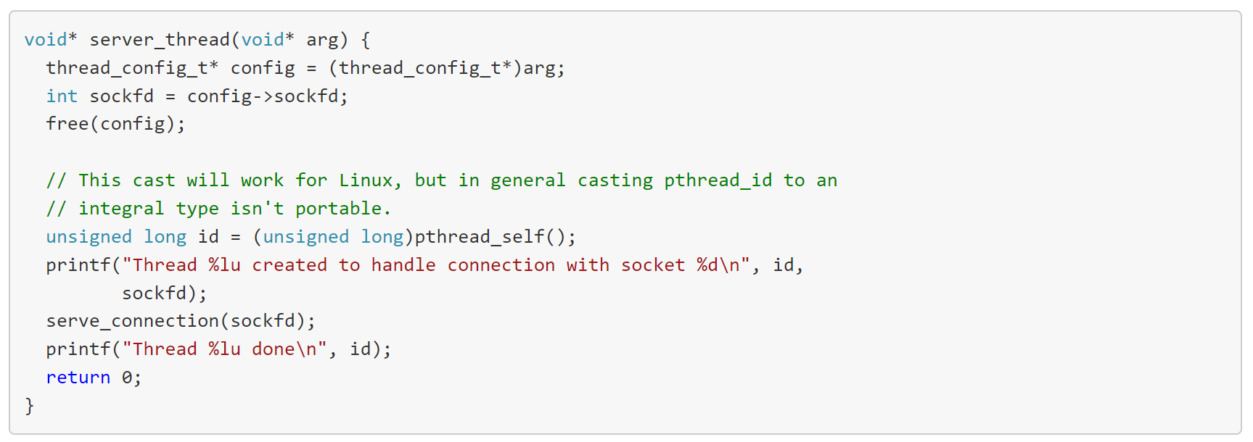
Sample code
Notes:
The diagrams shows 3 clients. The diamond shapes denote the client's "arrival time" (the time at which the client attempted to connect to the server). The black lines denote "wait time" (the time clients spent waiting for the server to actually accept their connection), and the colored bars denote actual "processing time" (the time server and client are interacting using the protocol). At the end of the colored bar, the client disconnects.
In the diagram above, even though the green and orange clients arrived shortly after the blue one, they have to wait for a while until the server is done with the blue client. At this point the green client is accepted, while the orange one has to wait even longer.
A multi-threaded server would launch multiple control threads, letting the OS manage concurrency on the CPU (and across multiple CPU cores). When a client connects, a thread is created to serve it, while the server is ready to accept more clients in the main thread. The time chart for this mode looks like the following:

Slide 26
Network programming
Solution: multi-threaded server
The problem of multi-threaded server:
Thread context switching is expensive.
Unlimited threads could consume too much resources.
Notes:
Even though threads are fairly efficient in terms of resource usage on modern OSes, the approach outlined in the previous section can still present challenges with some workloads.
Imagine a scenario where many clients are connecting simultaneously, and some of the sessions are long-lived. This means that many threads may be active at the same time in the server. Too many threads can consume a large amount of memory and CPU time just for the context switching [1]. An alternative way to look at it is as a security problem: this design makes it the server an easy target for a DoS attack - connect a few 100,000s of clients at the same time and let them all sit idle - this will likely kill the server due to excessive resource usage.
A larger problem occurs when there's a non-trivial amount of CPU-bound computation the server has to do for each client. In this case, swamping the server is considerably easier - just a few dozen clients can bring a server to its knees.
For these reasons, it's prudent the do some rate-limiting on the number of concurrent clients handled by a multi-threaded server. There's a number of ways to do this. The simplest that comes to mind is simply count the number of clients currently connected and restrict that number to some quantity (that was determined by careful benchmarking, hopefully). A variation on this approach that's very popular in concurrent application design is using a thread pool.

Slide 27
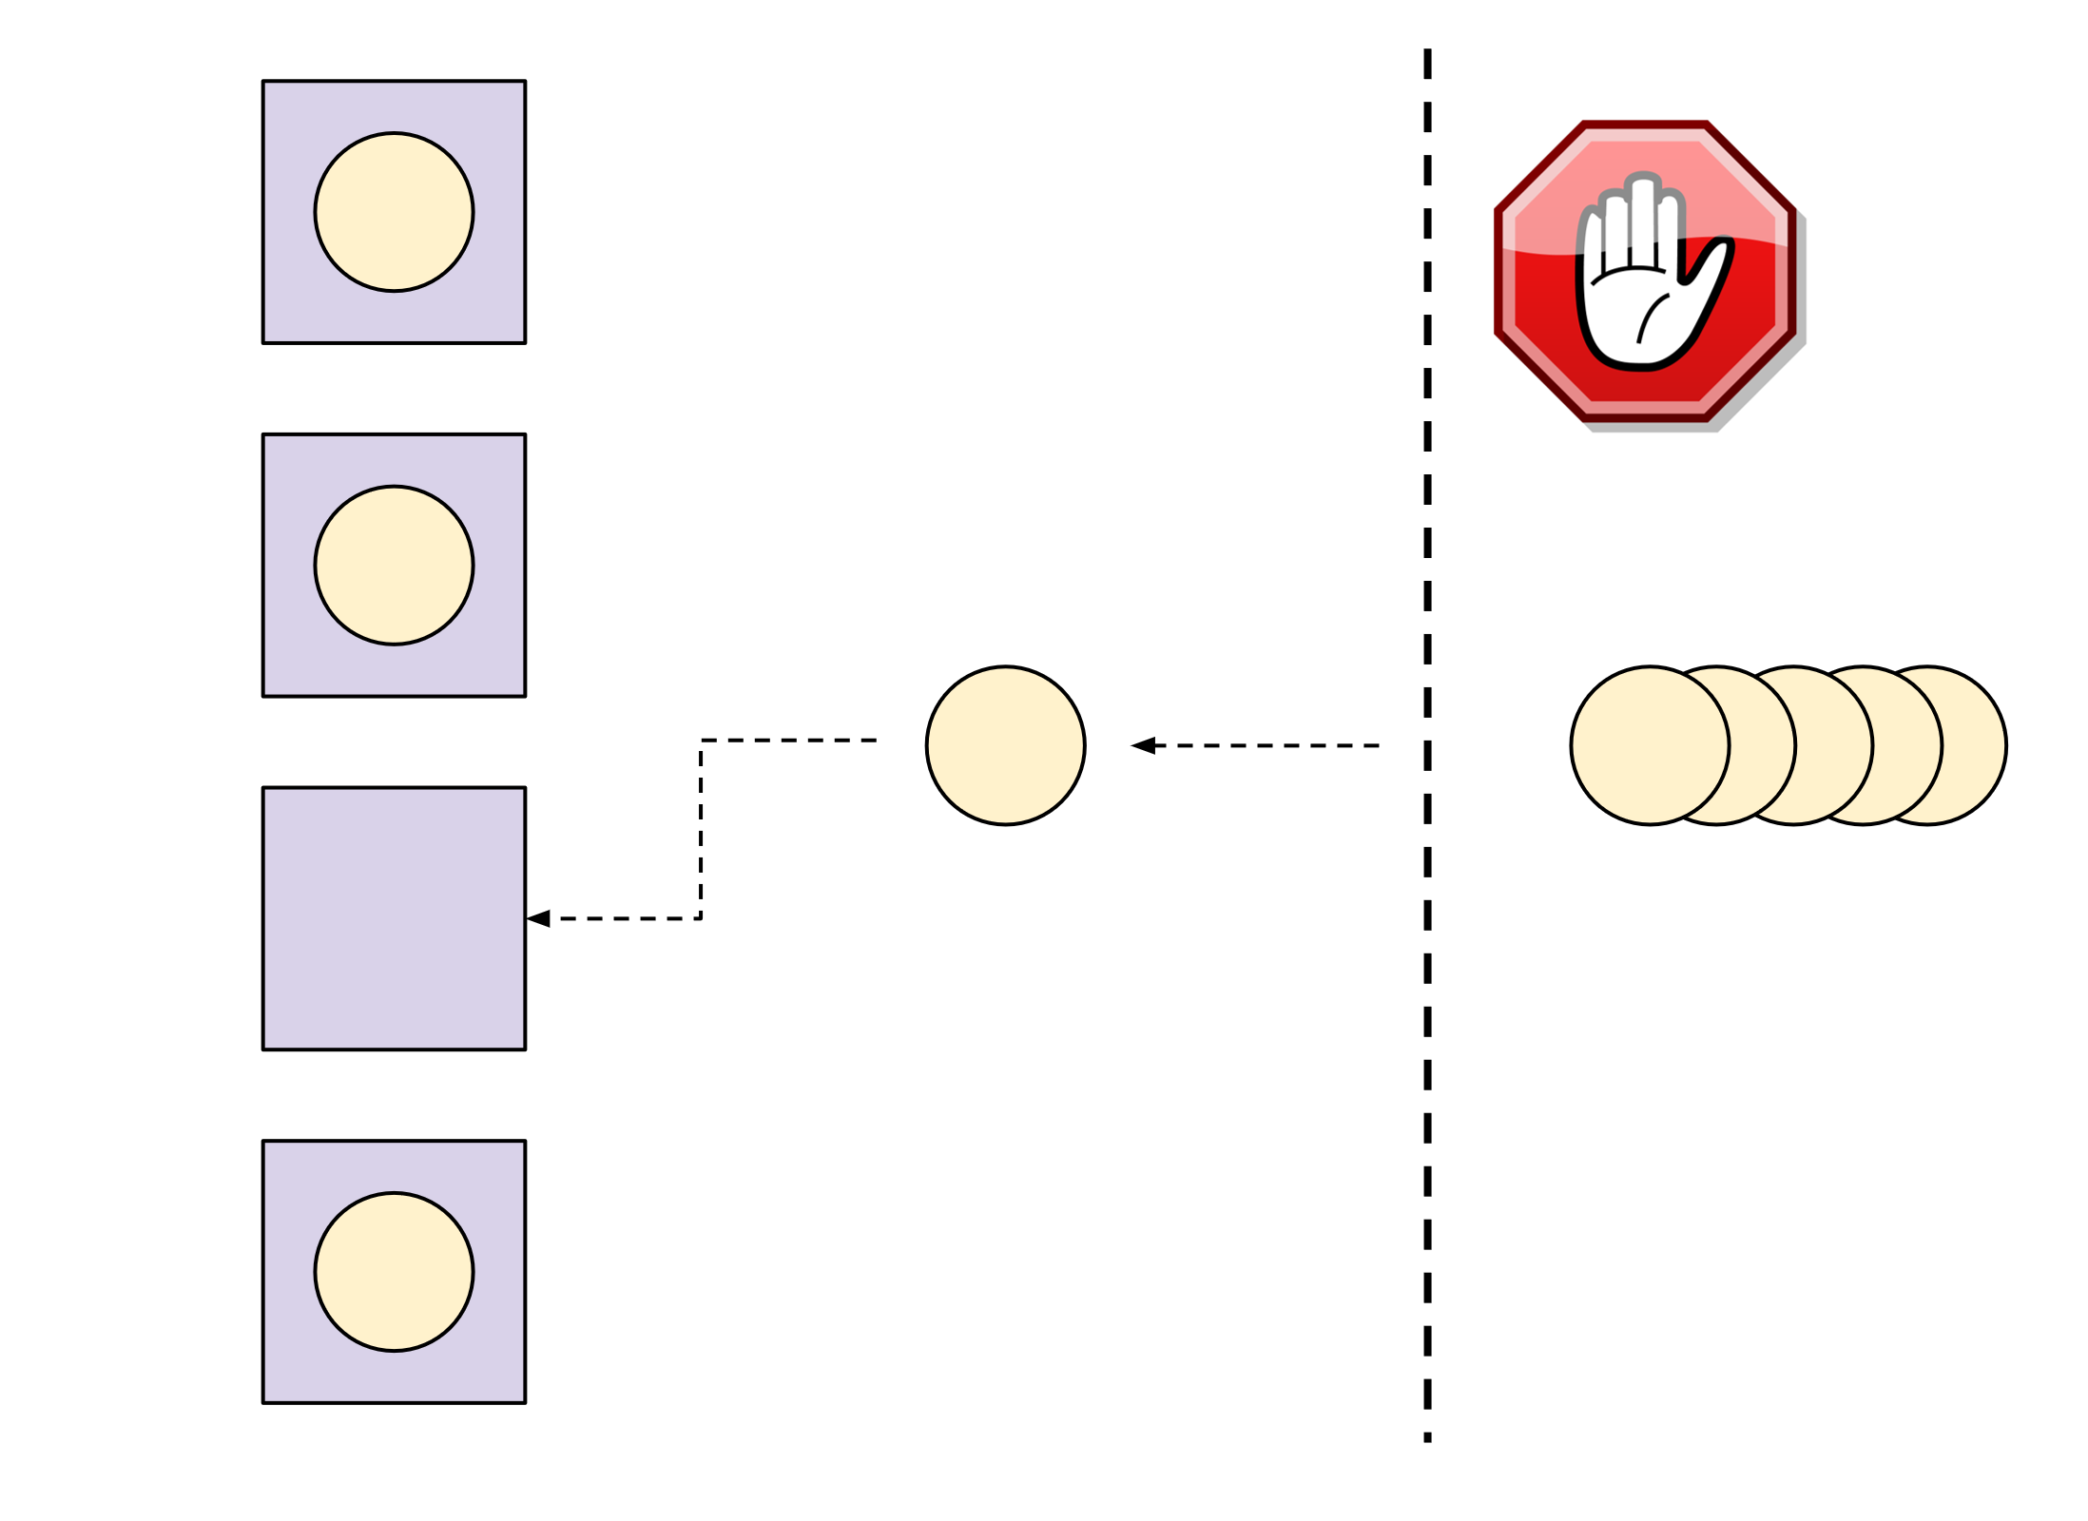
Network programming
Solution: multi-threaded server with thread pool
Very popular approach in concurrent application design.
The server creates a number of working threads that all expect to get tasks (the pool)
Each client connection is dispatched as a task to the pool
Provides a rate-limiting mechanism
Notes:
The server creates a number of working threads that all expect to get tasks from some queue. This is the "pool". Then, each client connection is dispatched as a task to the pool. As long as there's an idle thread in the pool, it's handed the task. If all the threads in the pool are currently busy, the server blocks until the pool accepts the task
It should be fairly obvious that the thread pool approach provides a rate-limiting mechanism in its very definition. We can decide ahead of time how many threads we want our server to have. Then, this is the maximal number of clients processed concurrently - the rest are waiting until one of the threads becomes free. If we have 8 threads in the pool, 8 is the maximal number of concurrent clients the server handles - even if thousands are attempting to connect simultaneously.
How do we decide how many threads should be in the pool? By a careful analysis of the problem domain, benchmarking, experimentation and also by the HW we have. If we have a single-core cloud instance that's one answer, if we have a 100-core dual socket server available, the answer is different. Picking the thread pool size can also be done dynamically at runtime based on load - I'll touch upon this topic in future posts in this series.
Implementing a thread pool from scratch is a fun exercise, but I‘ll leave it for another day 要不要重复造轮子?

Slide 28
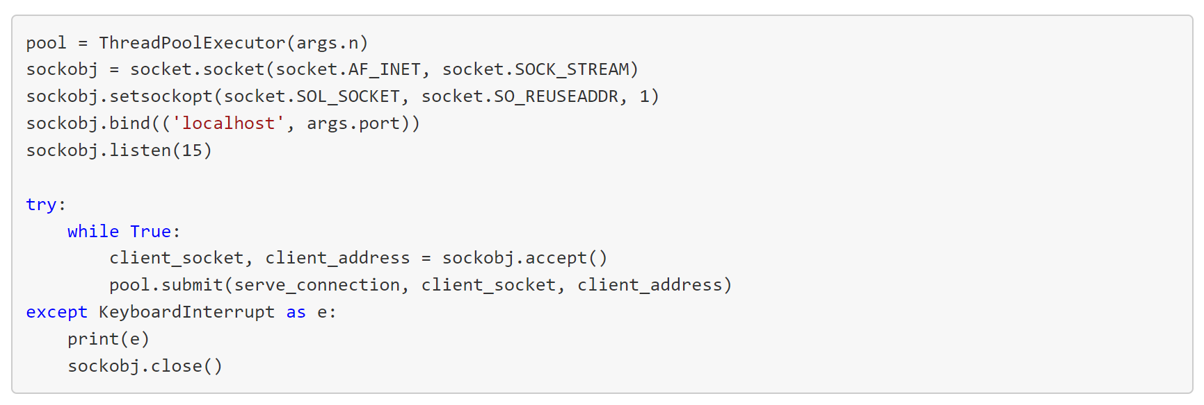
Sample code
Notes:
For this variation of the server I've switched to Python, which comes with a robust implementation of a thread pool in the standard library (ThreadPoolExecutor from the concurrent.futures module) [2].
This server creates a thread pool, then loops to accept new clients on the main listening socket. Each connected client is dispatched into the pool with submit:
Thread pools are much more common, and most popular programming languages have solid implementations (for some, like Python, it's in the standard library). The thread pool server presented here doesn't suffer from the problems of one-thread-per-client.

Slide 29
Network programming
What beyond the basic socket.
File transfer
Chat
Video steaming
User space
Kernel space
Hardware driver

Slide 30
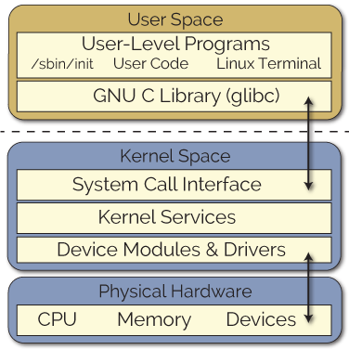
Network programming
Talk to Your Heart-- Linux Kernel Module Programming
Kernel is the core of the OS.
Software residing in memory that tells the CPU what to do.
Unrestricted access to the hardware
https://github.com/torvalds/linux/tree/master/kernel
Notes:
Kernel modules run in kernel space and applications run in user space, as illustrated in Figure 2. Both kernel space and user space have their own unique memory address spaces that do not overlap. This approach ensures that applications running in user space have a consistent view of the hardware, regardless of the hardware platform. The kernel services are then made available to the user space in a controlled way through the use of system calls. The kernel also prevents individual user-space applications from conflicting with each other or from accessing restricted resources through the use of protection levels (e.g., superuser versus regular user permissions).
http://derekmolloy.ie/writing-a-linux-kernel-module-part-1-introduction/

Slide 31
Network programming
How to talk to your heart?
Kernel Module (loadable kernel module, LKM): a mechanism for adding code to, or removing code from, the Linux kernel at run time.
A way to let users add functionalities into the kernel.
Notes:
However, kernel code is difficult to write and debug. My advice is that you should always to try to accomplish your task in Linux user space,
Both kernel space and user space have their own unique memory address spaces that do not overlap. This approach ensures that applications running in user space have a consistent view of the hardware, regardless of the hardware platform.
It is very easy to crash the system when you are writing and testing LKMs. It is always possible that such a system crash could corrupt your file system — it is unlikely, but it is possible. Please back up your data and/or use an embedded system, such as the BeagleBone, which can easily be re-flashed. Performing a sudo reboot, or pressing the reset button on the BeagleBone will usually put everything back in order. No BeagleBones were corrupted in the writing of these articles despite many, many system crashes!

Slide 32
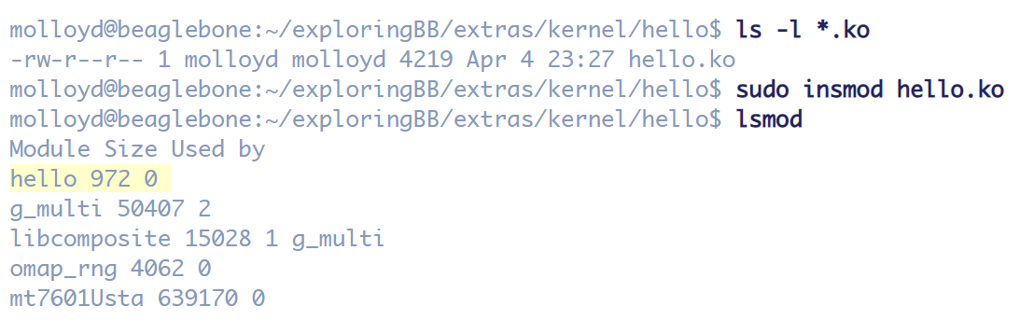
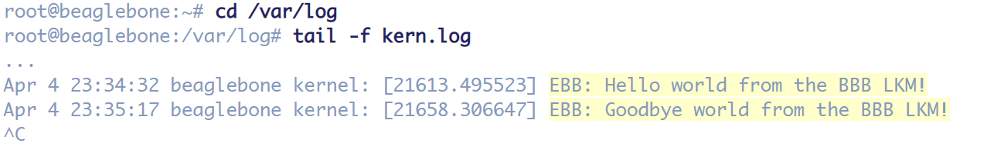
Network programming
Some basic operations of kernel module
Add a module to kernel
Remove a kernel from module
Listening to the kernel

Slide 33
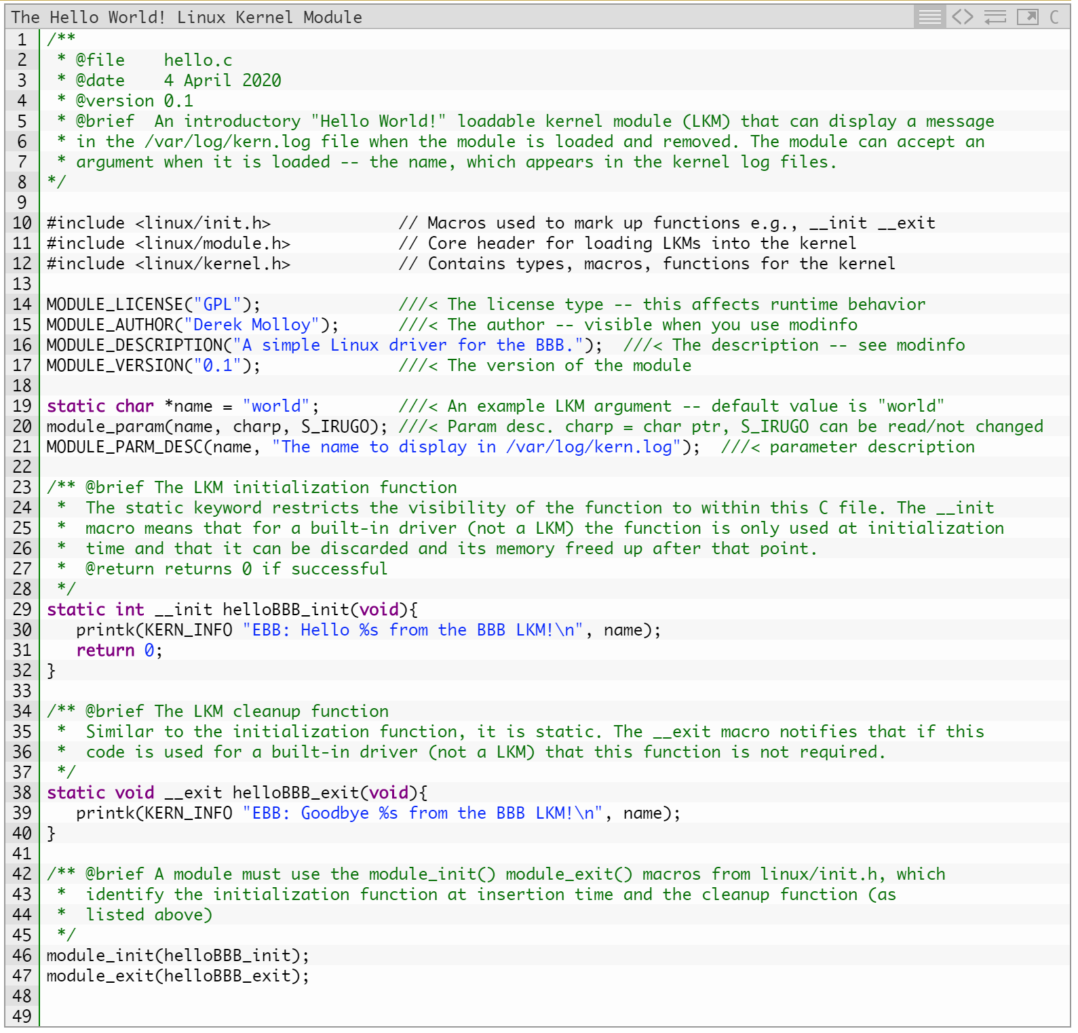
A kernel helloworld example
Something you must know about kernel programming
It does not execute sequentially
It does not have automatic cleanup
It does not have printf() functions
a higher level of execution privilege
Compile your source file using Makefile
Notes:
do not execute sequentially— a kernel module registers itself to handle requests using its initialization function, which runs and then terminates. The type of requests that it can handle are defined within the module code. This is quite similar to the event-driven programming model that is commonly utilized in graphical-user interface (GUI) applications.
do not have automatic cleanup — any resources that are allocated to the module must be manually released when the module is unloaded, or they may be unavailable until a system reboots.
do not have printf() functions — kernel code cannot access libraries of code that is written for the Linux user space. The kernel module lives and runs in kernel space, which has its own memory address space. The interface between kernel space and user space is clearly defined and controlled. We do however have a printk() function that can output information, which can be viewed from within user space.
can be interrupted — one conceptually difficult aspect of kernel modules is that they can be used by several different programs/processes at the same time. We have to carefully construct our modules so that they have a consistent and valid behavior when they are interrupted. The BeagleBone has a single-core processor (for the moment) but we still have to consider the impact of multiple processes accessing the module simultaneously.
have a higher level of execution privilege — typically, more CPU cycles are allocated to kernel modules than to user-space programs. This sounds like an advantage, however, you have to be very careful that your module does not adversely affect the overall performance of your system.
do not have floating-point support — it is kernel code that uses traps to transition from integer to floating-point mode for your user space applications. However, it is very difficult to perform these traps in kernel space. The alternative is to manually save and restore floating point operations — a task that is best avoided and left to your user-space code.

Slide 34
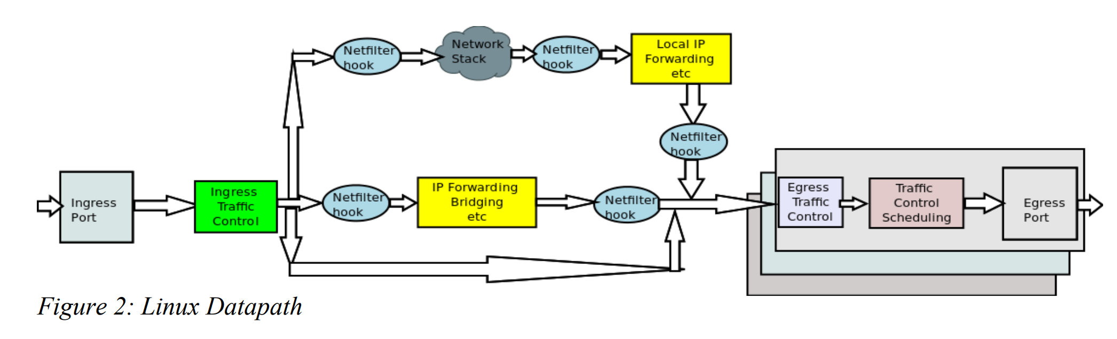
Network programming
How to process packets in the kernel?
Linux netfilter framework
Linux traffic control framework

Slide 35
Network programming
Linux netfilter framework
Netfilter is a framework inside the Linux kernel which offers flexibility for various networking-related operations to be implemented in form of customized handlers. Netfilter offers various options for packet filtering, network address translation, and port translation.
netfilter: http://www.netfilter.org/index.html
iptables: http://www.netfilter.org/projects/iptables/index.html
Notes:
http://wiki.dreamrunner.org/public_html/Linux/Networks/netfilter.html

Slide 36
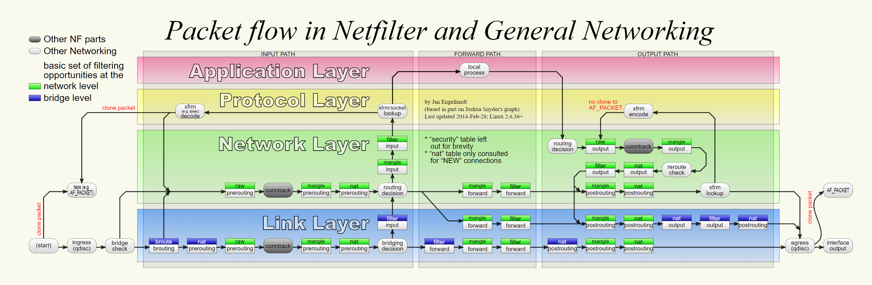
Network programming
5 hooks of netfilter
Notes:
http://wiki.dreamrunner.org/public_html/Linux/Networks/netfilter.html

Slide 37
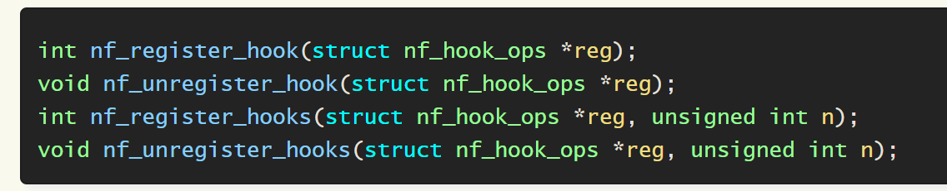
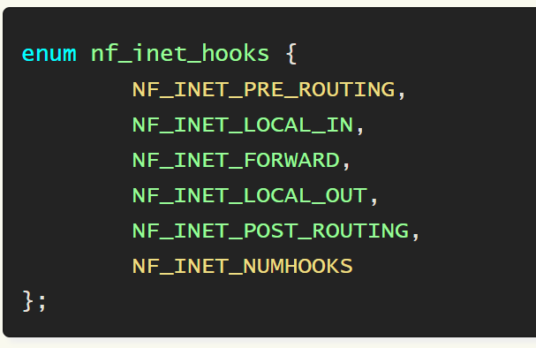
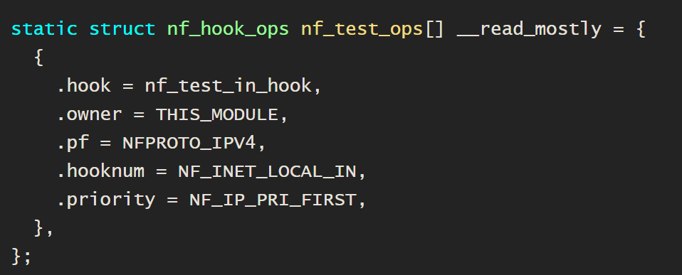
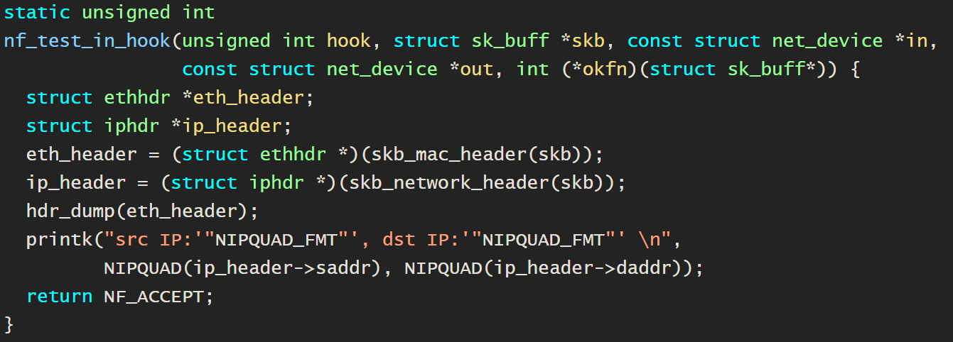
2. Register the hooks in the kernel module :
1. The hooks:
3. Define the hook operations:
4. Manipulates the packets using skb:
Notes:
http://wiki.dreamrunner.org/public_html/Linux/Networks/netfilter.html

Slide 38
Network programming
2. Linux traffic control framework
Linux traffic control (TC) is a tool for managing and manipulating the transmission of packets.
TC has a set of queuing systems and mechanisms by which packets are received and transmitted
Deciding which (and whether) packets to accept at what rate on the input of an interface
Determining when packets to transmit in what order at what rate on the output of an interface
Notes:
http://wiki.dreamrunner.org/public_html/Linux/Networks/netfilter.html

Slide 39
Network programming
2. Linux traffic control framework
2 traffic control points.

Slide 40
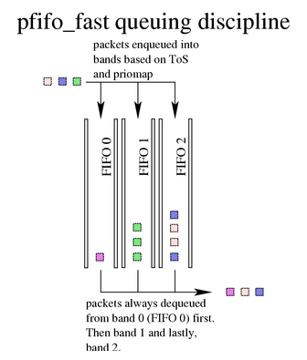
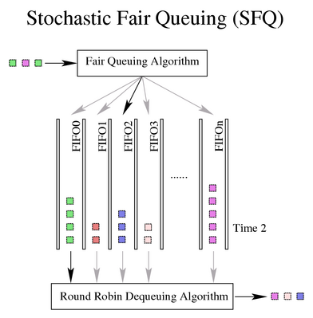
Network programming
2. Linux traffic control framework
Custom your own packet scheduler using Qdisc
Every output interface needs a scheduler of some kind

Slide 41
Review
Network programming
Userspace programming
Sockets
Concurrent servers
Kernel space programming
Kernel module: how to write and insert a module
Netfilter: how to manage packets in the kernel
Linux traffic control: how to customize Qdisc

Slide 42
数据中心网络
Datacenter Network and Related Research Topics
Lesson 07

Slide 43
A kernel helloworld example
Something you must know about kernel programming
It does not execute sequentially
It does not have automatic cleanup
It does not have printf() functions
a higher level of execution privilege
Compile your source file using Makefile
Notes:
do not execute sequentially— a kernel module registers itself to handle requests using its initialization function, which runs and then terminates. The type of requests that it can handle are defined within the module code. This is quite similar to the event-driven programming model that is commonly utilized in graphical-user interface (GUI) applications.
do not have automatic cleanup — any resources that are allocated to the module must be manually released when the module is unloaded, or they may be unavailable until a system reboots.
do not have printf() functions — kernel code cannot access libraries of code that is written for the Linux user space. The kernel module lives and runs in kernel space, which has its own memory address space. The interface between kernel space and user space is clearly defined and controlled. We do however have a printk() function that can output information, which can be viewed from within user space.
can be interrupted — one conceptually difficult aspect of kernel modules is that they can be used by several different programs/processes at the same time. We have to carefully construct our modules so that they have a consistent and valid behavior when they are interrupted. The BeagleBone has a single-core processor (for the moment) but we still have to consider the impact of multiple processes accessing the module simultaneously.
have a higher level of execution privilege — typically, more CPU cycles are allocated to kernel modules than to user-space programs. This sounds like an advantage, however, you have to be very careful that your module does not adversely affect the overall performance of your system.
do not have floating-point support — it is kernel code that uses traps to transition from integer to floating-point mode for your user space applications. However, it is very difficult to perform these traps in kernel space. The alternative is to manually save and restore floating point operations — a task that is best avoided and left to your user-space code.

Slide 44
Network programming
2. Linux traffic control framework
Custom your own packet scheduler using Qdisc
Every Qdisc is a kernel module!
See github linux source code for an example:
https://github.com/torvalds/linux/blob/master/net/sched/sch_prio.c

Slide 45
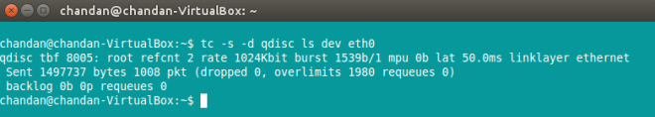
Network programming
2. Linux traffic control framework
Add and remove your own Qdisc to the interface
https://www.tldp.org/HOWTO/html_single/Traffic-Control-HOWTO/

Slide 46
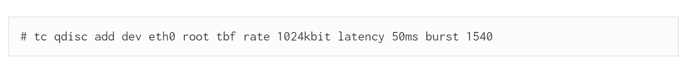
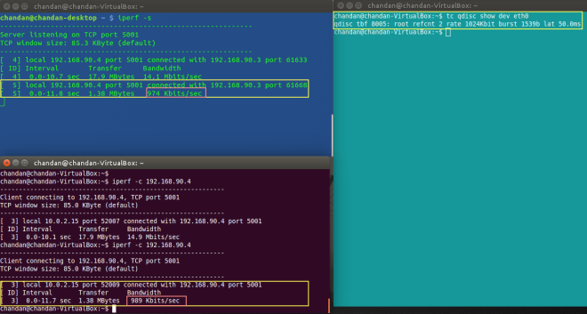
Network programming
2. Linux traffic control framework
Add and remove your own Qdisc to the interface

Slide 47
Review
Network programming
Userspace programming
Sockets
Concurrent servers
Kernel space programming
Kernel module: how to write and insert a module
Netfilter: how to manage packets in the kernel
Linux traffic control: how to customize Qdisc

Slide 48
Network programming in the kernel
Kernel space programming
Kernel module: how to write and insert a module
Netfilter: how to manage packets in the kernel
Linux traffic control: how to customize Qdisc
What’s the limitation of current kernel programming?
Prone to errors and bugs
Functionally limited
Can not adapt to kernel change
….

Slide 49
Network programming in the kernel
Kernel space programming
Potentially the ultimate solution: eBFP
What is eBFP?
Extended Berkeley Packet Filter -eBFP
NOT the classic Berkeley Packet Filter is first proposed in 1992

Slide 50

Network programming in the kernel
What is eBFP?
Extended Berkeley Packet Filter –eBFP
https://ebpf.io/
eBPF is a revolutionary technology with origins in the Linux kernel that can run sandboxed programs in an operating system kernel.
Notes:
It is used to safely and efficiently extend the capabilities of the kernel without requiring to change kernel source code or load kernel modules.

Slide 51
Network programming in the kernel
Historically, the operating system kernel has always been an ideal place for programmers
Due to the kernel’s privileged ability to oversee and control the entire system
User space
Kernel space
Hardware driver
Notes:
At the same time, an operating system kernel is hard to evolve due to its central role and high requirement towards stability and security. The rate of innovation at the operating system level has thus traditionally been lower compared to functionality implemented outside of the operating system.

Slide 52
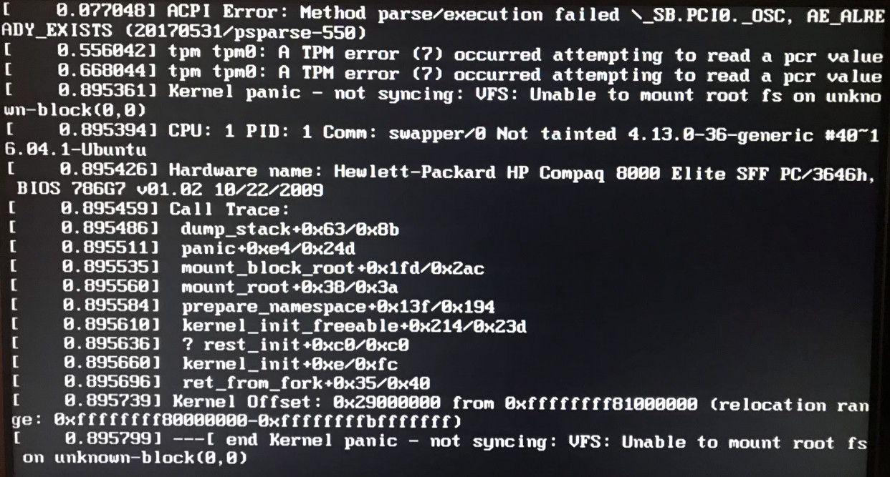
Network programming in the kernel
However, the operating system kernel has always been an ideal nightmare place for programmers
high requirement towards stability and security
Notes:
At the same time, an operating system kernel is hard to evolve due to its central role and high requirement towards stability and security. The rate of innovation at the operating system level has thus traditionally been lower compared to functionality implemented outside of the operating system.

Slide 53
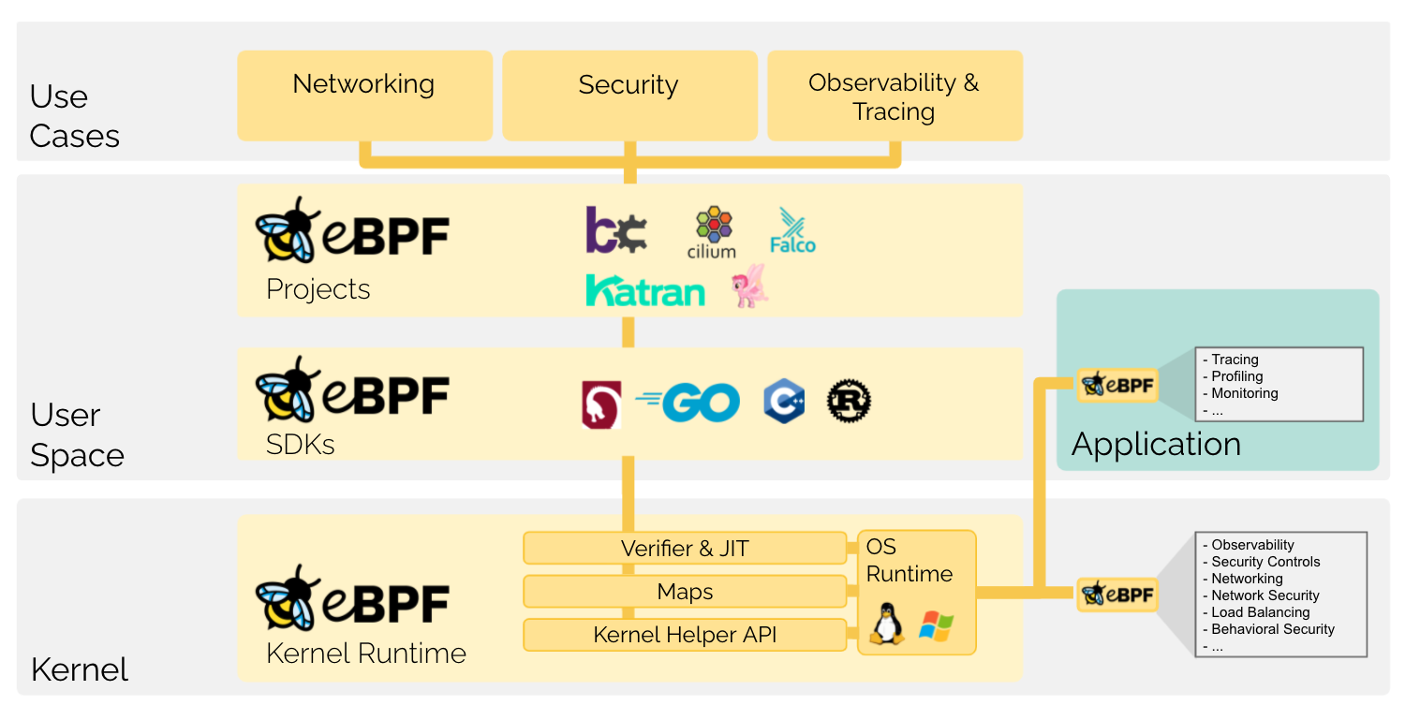
Network programming in the kernel
eBPF changes this formula fundamentally.
By allowing to run sandboxed programs in the kernel
Notes:
eBPF changes this formula fundamentally. By allowing to run sandboxed programs within the operating system, application developers can run eBPF programs to add additional capabilities to the operating system at runtime. The operating system then guarantees safety and execution efficiency as if natively compiled with the aid of a Just-In-Time (JIT) compiler and verification engine. This has led to a wave of eBPF-based projects covering a wide array of use cases, including next-generation networking, observability, and security functionality.

Slide 54
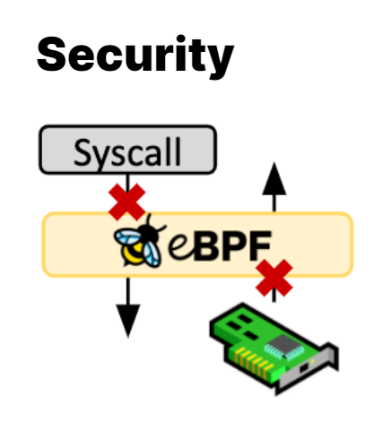
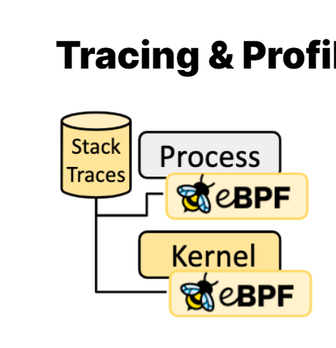
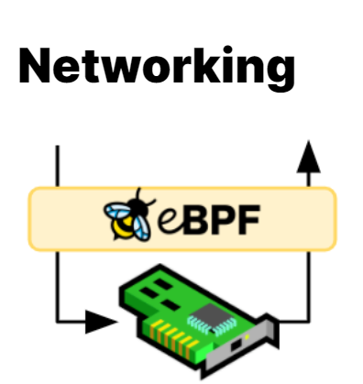
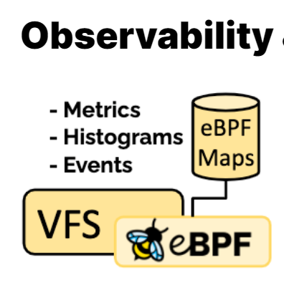
Network programming in the kernel
Today, eBPF is used extensively to drive a wide variety of use cases:
Security
Tracing & Profiling
Networking
Observability & Monitoring
Notes:
Building on the foundation of seeing and understanding all system calls and combining that with a packet and socket-level view of all networking operations allows for revolutionary new approaches to securing systems. While aspects of system call filtering, network-level filtering, and process context tracing have typically been handled by completely independent systems, eBPF allows for combining the visibility and control of all aspects to create security systems operating on more context with better level of control.
The ability to attach eBPF programs to trace points as well as kernel and user application probe points allows unprecedented visibility into the runtime behavior of applications and the system itself. By giving introspection abilities to both the application and system side, both views can be combined, allowing powerful and unique insights to troubleshoot system performance problems. Advanced statistical data structures allow to extract meaningful visibility data in an efficient manner, without requiring the export of vast amounts of sampling data as typically done by similar systems.
The combination of programmability and efficiency makes eBPF a natural fit for all packet processing requirements of networking solutions. The programmability of eBPF enables adding additional protocol parsers and easily program any forwarding logic to meet changing requirements without ever leaving the packet processing context of the Linux kernel. The efficiency provided by the JIT compiler provides execution performance close to that of natively compiled in-kernel code.
Instead of relying on static counters and gauges exposed by the operating system, eBPF enables the collection & in-kernel aggregation of custom metrics and generation of visibility events based on a wide range of possible sources. This extends the depth of visibility that can be achieved as well as reduces the overall system overhead significantly by only collecting the visibility data required and by generating histograms and similar data structures at the source of the event instead of relying on the export of samples.

Slide 55
Homework
Install VMware workstation
Install Ubuntu 18.04
Then let’s make a little piece of coding…
Before that… let’s see a video first ☺

Slide 56
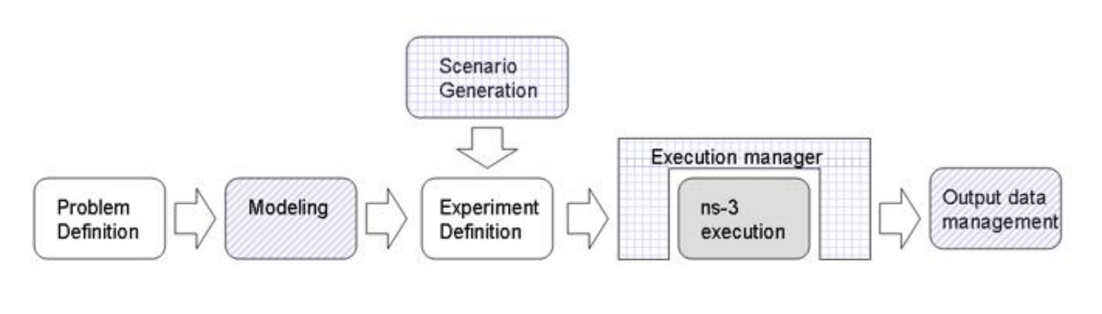
Supplementary material
Network programming using NS-3
Model of the evolution of a networked system through discrete events in time
Used for experimentation and education

Slide 57
Supplementary material
Network programming using NS-3
You want to study network performance or protocol operation in a controllable or scalable environment
You are comfortable writing C++ or Python code, and combining ns-3 with other code
ns-3 has the models you are looking for
– or you can provide/integrate what is lacking

